Slide 1
Group Gift - Application
By Jacob Gerber, Jacob Biggs, Devon Roe, Jagdeep Singh Bankole Adegboye, Gabe Mcmahon, James Lewis, Zack Santee

Slide 2
Objective and Target Audience
Our Objective: Our objective when making our application was to create an application to allow people to collaborate in the gift buying process. It involves people creating registries for their parties and sharing it with others to make the process easier. Collaboration is mostly in the form of showing users what other users have already bought for the party in order to minimize two people buying the same gift or allow two people to get complimentary gifts that they wouldn’t have otherwise.
Target Audience:Our target audience focuses on adults who have kids, but is not necessarily limited to that group. Most of our design focuses on helping to give those parents a way to organize with other parents to get gifts for the child without having two people get the same gifts. We also saw that it could be used in other forms like with weddings or graduation but those were not the target audiences we primarily focused on.

Slide 3
Other Program Research
Google Docs
We researched Google Docs because of its ability to collaborate with other users. The things we liked with it was its ability to work with others in real time which we tried to include in our design. The problem that we found with this program is that it does not share many other similarities with our app beside the collaboration focus.
Amazon
We researched Amazon because of its large database of gifts and its wish list functions. We really liked just how large Amazon’s gift library was, and how it would suggest gifts based on different groups (toddlers, teen boys, women, etc.) We didn’t like that Amazon isn’t collaborative in real time, and is somewhat limited for parties.

Slide 4
Other Product Research (cont.)
Remember the Milk
We researched RTM because it came up as an excellent choice for most of the criteria. RTM fulfils nearly all of the things we asked about, from different lists to the ability to share them with others. The biggest issue for RTM is that some features are ‘upgrade-only’ and it requires all members using an upgraded version to have it (at a price of $39.99 a year).
Reminders (iOS)
We researched Reminders because it comes standard with all Apple devices. Reminders allows for collaboration (to people on the same iCloud account) and even proximity-based alerts (using your phone’s location services feature). The problem with Reminders is that to our knowledge, it’s exclusive to Apple products. In addition, the sharing feature is rather limited.

Slide 5
Our User Study
The main purpose of this study was to find users preferences about what they would want in an application. Some of the questions we asked during user study was:
Do you have a smartphone?
Have you ever used a registry for an event before?
Would you prefer to use an application to keep track of your registry?
Does your cell phone have a stable internet connection?
These questions helped us understand how we should design our application so users will not have any difficulty while using the application.

Slide 6
Findings from the User Study
The ability to collaborate over distance is one of the major benefits of our app.
A common problem is information overload and then lacking any sort of ‘Help’ functionality.
People would be open to trying our app if it worked well.
People would recommend our app to others if it worked well
Application security is important to users.
Making sure to have some sort of help section is something people deem useful and necessary.
Opinions on Social media integration vary between people.
Alerts and notifications from the app should be customizable and infrequent.
Users want the most simple application they can get.

Slide 7
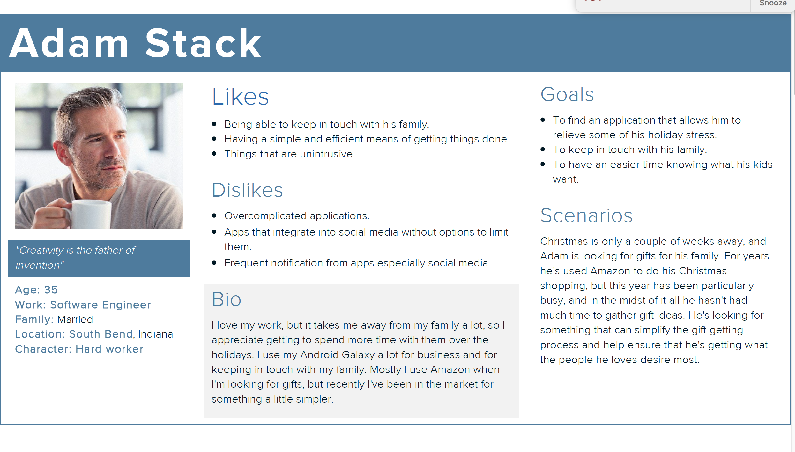
Our Persona

Slide 8
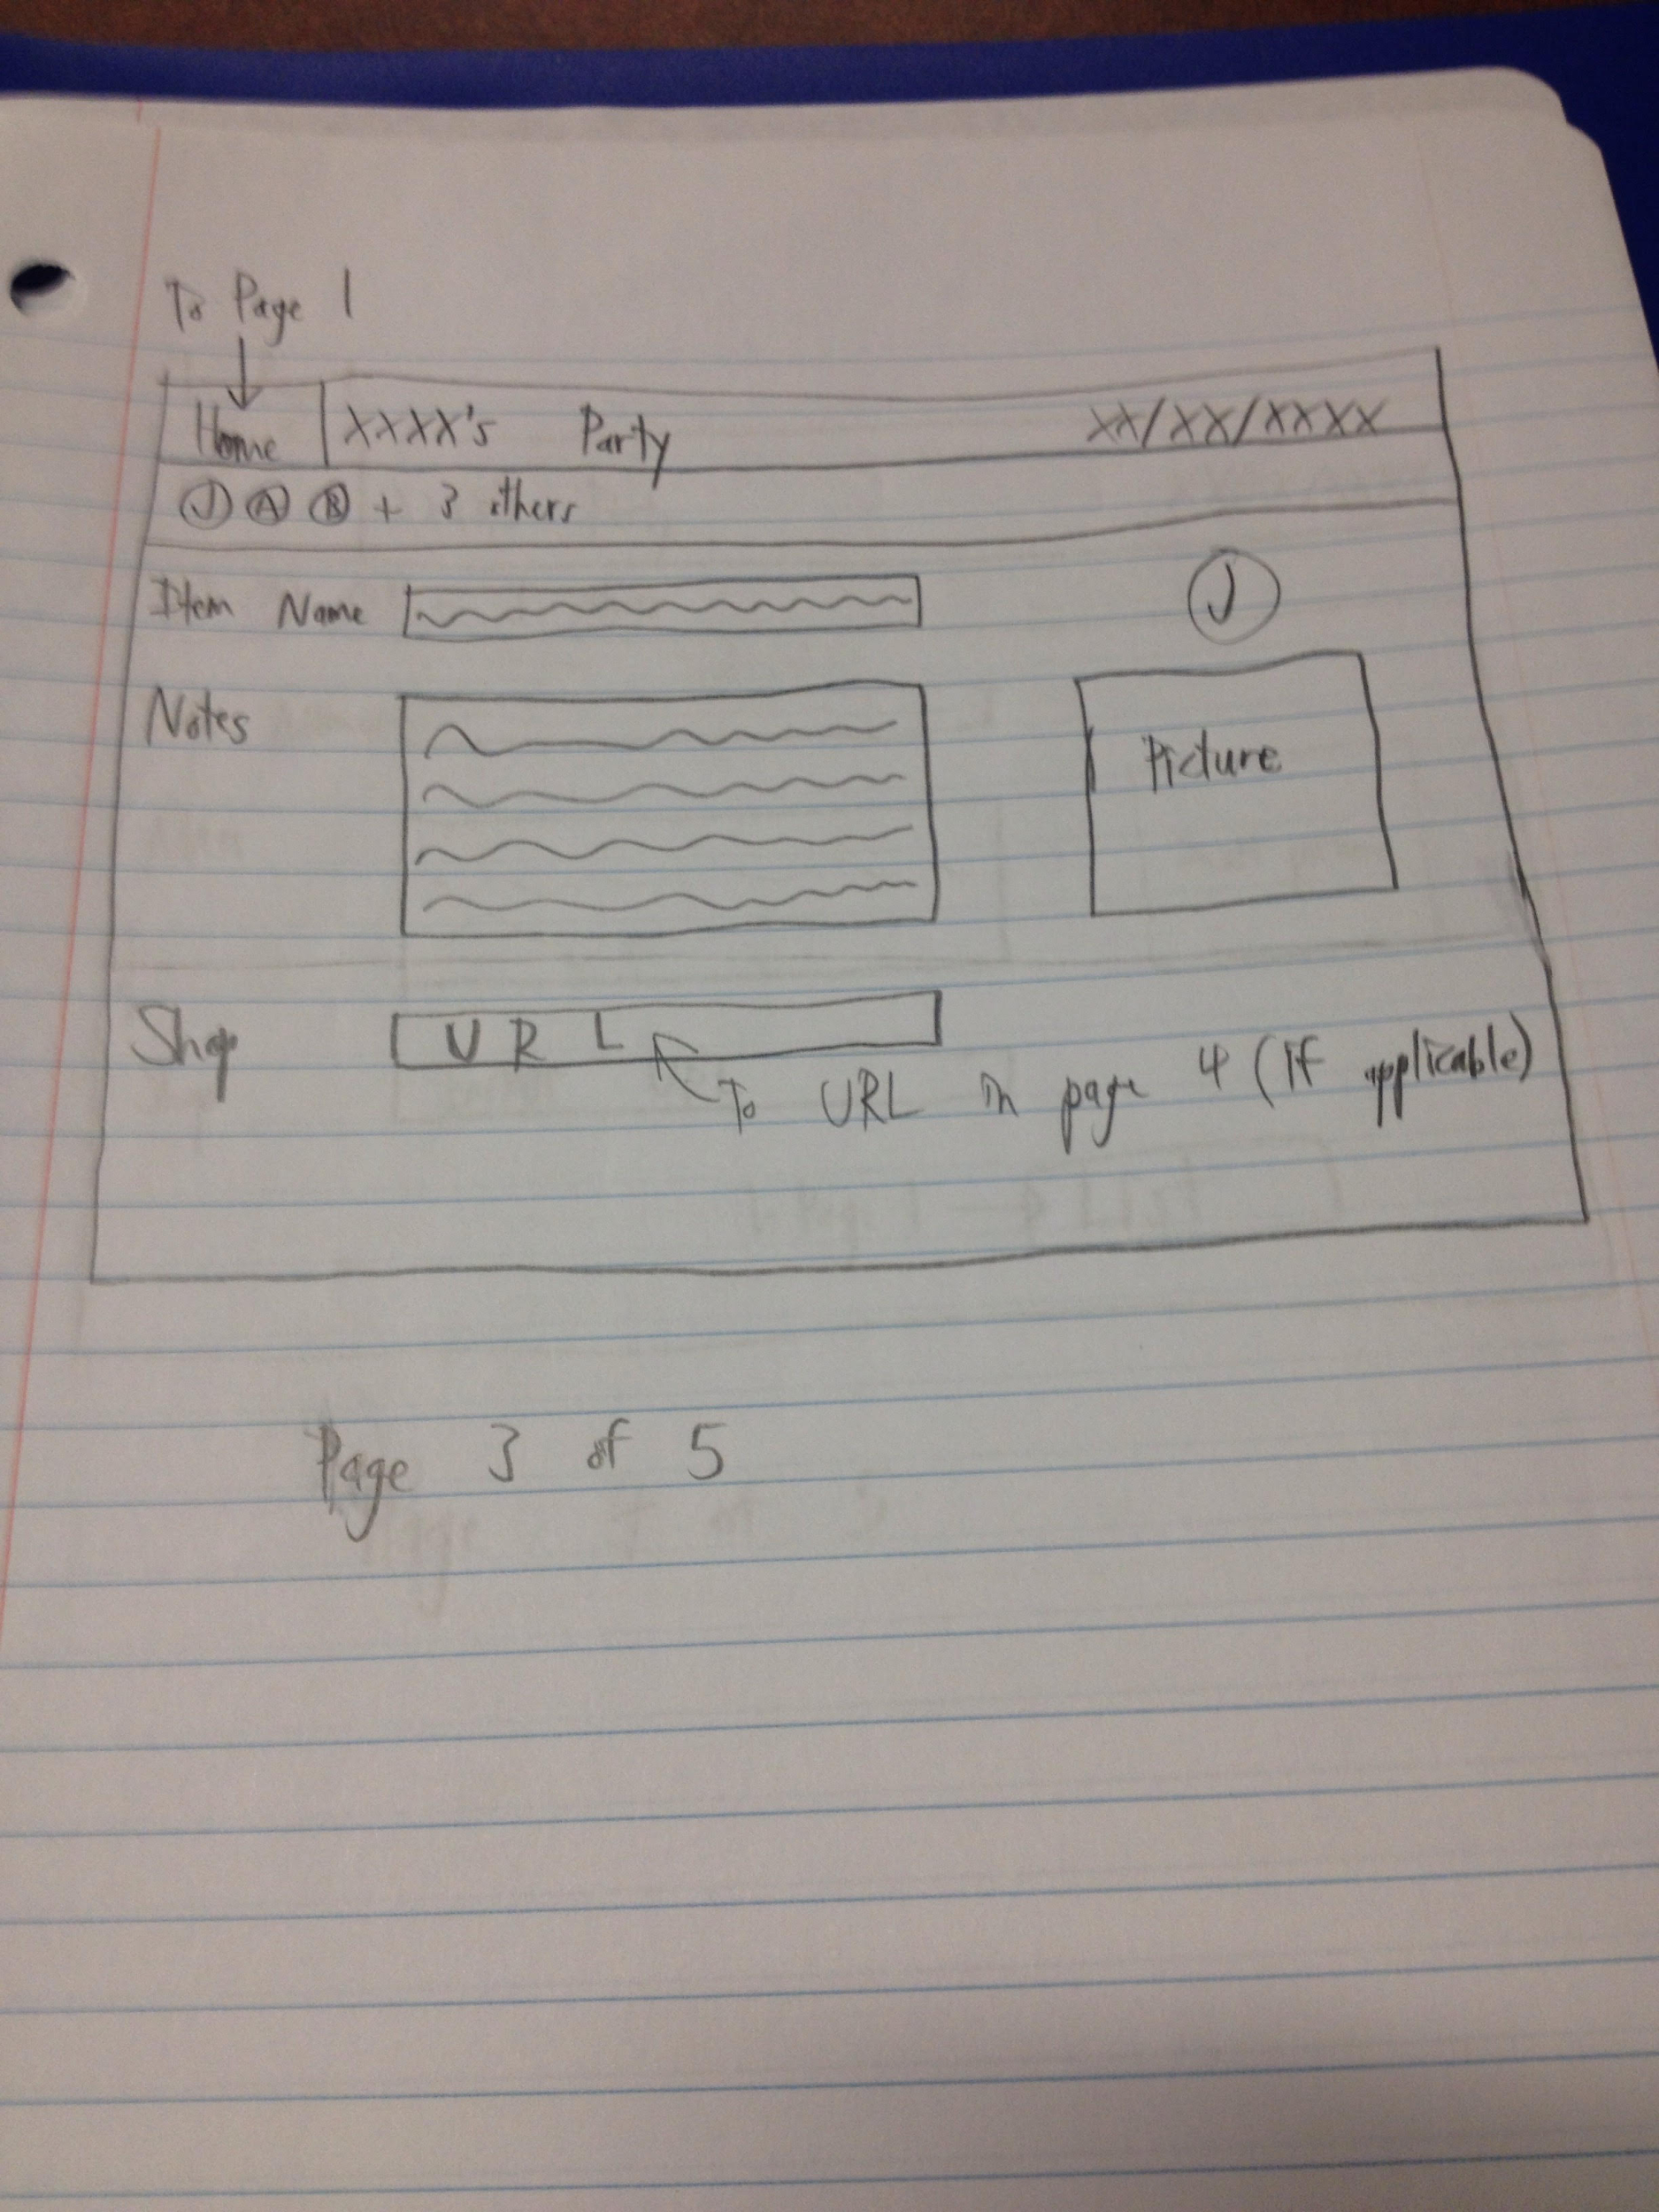
Our Designs (Jacob Biggs)
This was a preliminary design for the item listing page.
It allows for the person who created the registry to input the name of an item, notes about the item, a picture of the item, and a URL that leads to the item on a page such as Amazon. The Home button is in the upper-left corner of the screen.

Slide 9
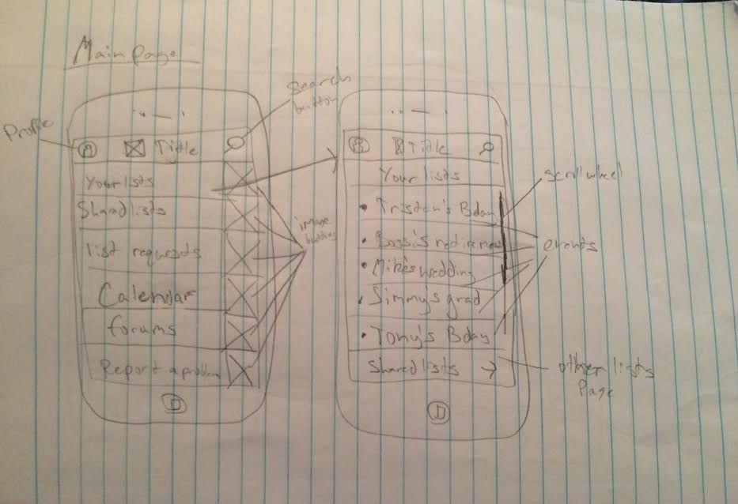
Our Designs (Devon Roe)
This is the design for the main page of the app
It mostly serves as a menu for taking users to different functions within the app, while not doing very many functions on its own.

Slide 10
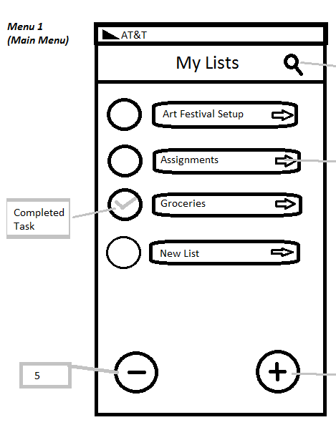
Our Designs (Gabe)
My design borrowed from the design of Google Drive for Android and Reminders for IOS
Each item is its own entity with a minimalistic design with an emphasis on information
Tapping a list would take you to a similar page with items specific for that list

Slide 11
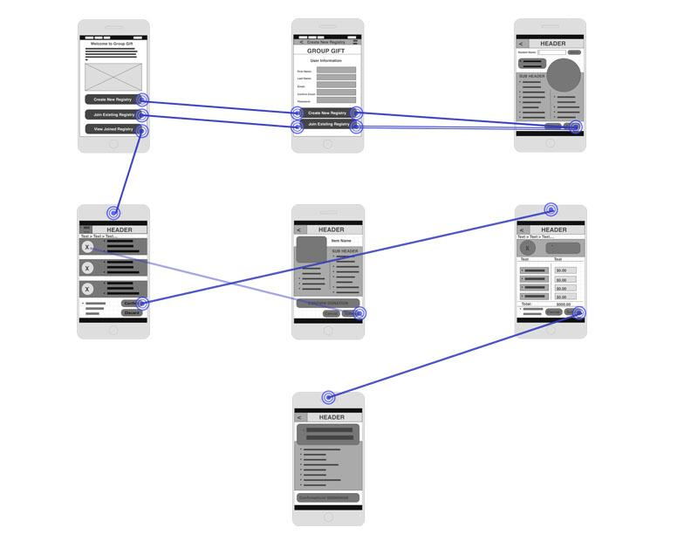
Our Design: James Lewis
My design was inspired by multiple applications that you see today.
This draft is just a low fidelity of what the final version may look like.
Note that some of the detail may or may not be included in the high fidelity image.

Slide 12
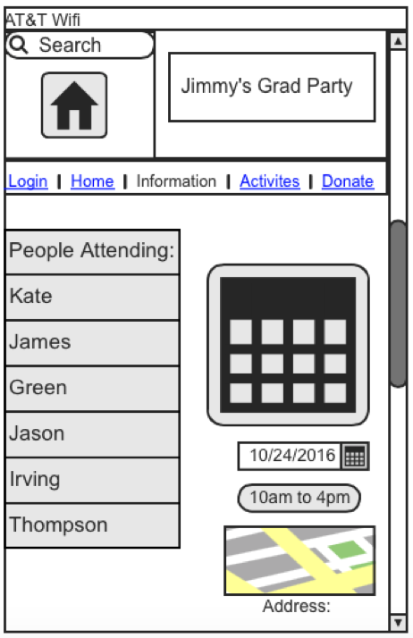
Our Designs (Jagdeep Singh)
My design is inspired by the combination of most application designs that i like, or the applications I have used or using right now.
This Page is a Information page. This page provides all the information about the event. For example:
Who is attending the event.
What time and date.
The address and place.

Slide 13
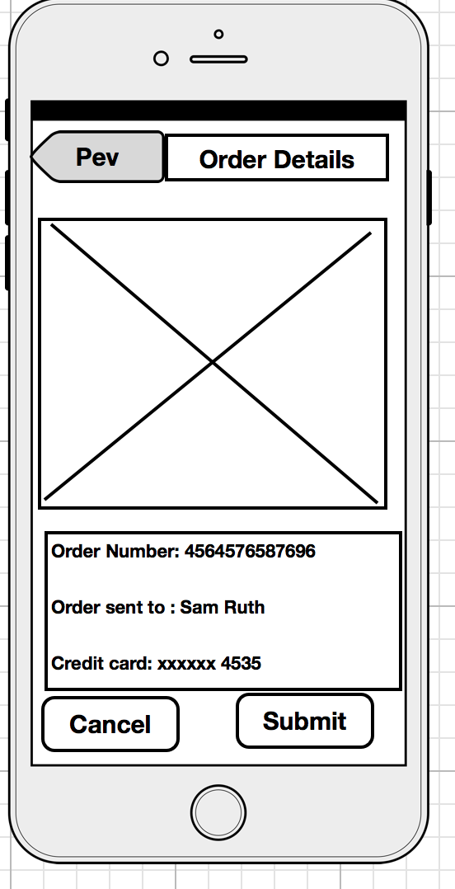
Our Designs (Bankole Adegboye)
My design is a borrowed inspiration from Amazon and ebay.
This a page that will serve as a confirmation page to make sure the user want to buy the item
If the user wants to make any changes to the order they are about to pay for.
If they don't they can just press the cancel button.

Slide 14
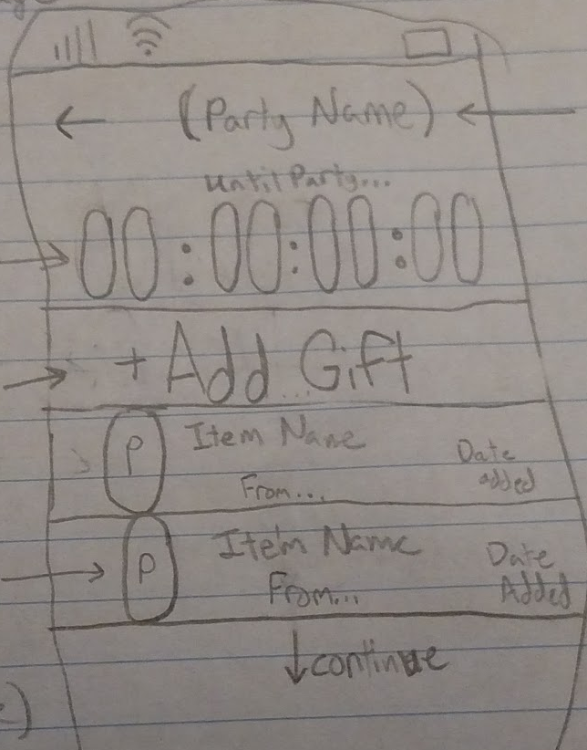
Our Design (Jacob Gerber)
This page is a design for the hub for each party/registry. I took a lot of inspiration from my Assignment 2 wireframe among other apps that I took ideas from.
The basic idea is that it serves as a hub for both showing when the party is and allowing people to add the gifts to the registry. This page itself does not have many functions but instead is the screen that leads to those various functions.

Slide 15
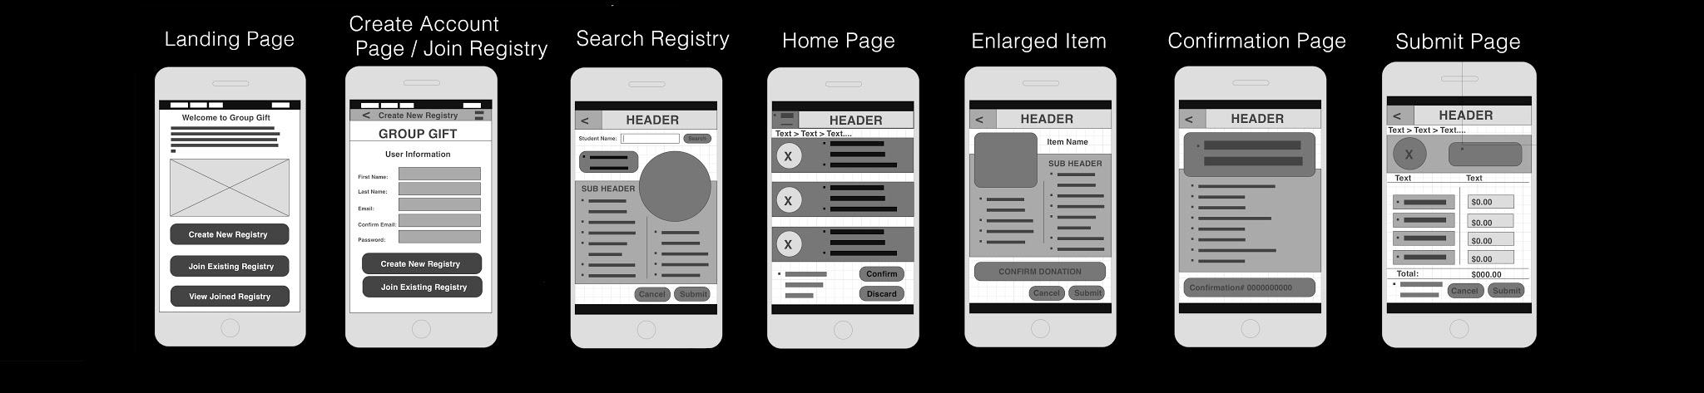
Low Fidelity Prototype (Landing Page)
This is the basic landing page for our app that the user is taken to when first launching the app.
The only functions this page serves is to move users onto different pages within the app with the major functionality of our site.

Slide 16
Low Fidelity Prototype (Create Account)
This is the page you are taken to after clicking on either the ‘Create New Registry’ or ‘Join Existing Registry’ buttons on the Landing Page.
It serves to allow users to create their account in order to create a new registry or join an existing one. The account on this site will allow users to be able to return to a registry after deleting the application or bring up their registry from another person’s device.

Slide 17
Low Fidelity Prototype (Search Registry)
This is the Search registry page. After creating an account or logging in the user will come to the search registry page.
The user can insert a name of someone who has already been listed in the directory. As you search a name, information will populate the fields that you see here.

Slide 18
Low Fidelity Prototype (Home Page)
This home page appears after someone has been selected. This page shows a list of items the person may desire.
You can select or click to enlarge. It is up to the user.

Slide 19
Low Fidelity Prototype (Enlarged Item)
Here the user can enlarge the item to obtain detail about the item.
This page goes into specifics almost as if the person is pleading their case.

Slide 20
Low Fidelity Prototype (Submit Page)
This is the submit page.
This page populates all the items with cost. (I would like to mention that the user will be able to submit payment information in the menu. If no payment is made a modal window requiring payment information will appear for the user)

Slide 21
Low Fidelity Prototype (Confirmation Page)
This is the confirmation page.
Here is where you confirm the selected item or items that you want to fund for the receiving person.
You are then given a confirmation number

Slide 22
Usability Test
In the usability test our main focus was to make sure users understand the application, to get suggestions and feedbacks. Some of the question we used in Usability test were:
Have you ever used a gift registry app before?
Have you ever been in a position where two people had purchased the same gift?
Does your cell phone have a stable internet connection?
The reason why we asked a lot of question to make sure our design had all the necessary functions that the users will want in an application. We made users do some tasks over our low fidelity prototype. Some of the task we made users do were:
Describe out loud what you see and what you think the page does?
What do you think will be on the next page?
We asked users to perform a money donation on the application in addition to a gift donation.

Slide 23
Usability Test Findings
While doing usability testing we found a lot of users were having trouble answering question because it’s a low fidelity prototype and it’s not completely finished. We found a lot of concepts that users were struggling in for example:
Users were not sure how to go back to the homepage or users wanted to have a simpler way of getting to the shopping cart/checkout. Users were having struggle finding “next” button. All of our users thought that the design was really simple and easy to use. We found that users have never used an gift registry application before.
Some feedback we got from our users:
Users thought that the design was really difficult to figure out just because it was low fidelity prototype.
Users responded that they would recommend this application 3 out of 5 people. Most of our users said that they will be able to perform the task alone when the design is finished.

Slide 24
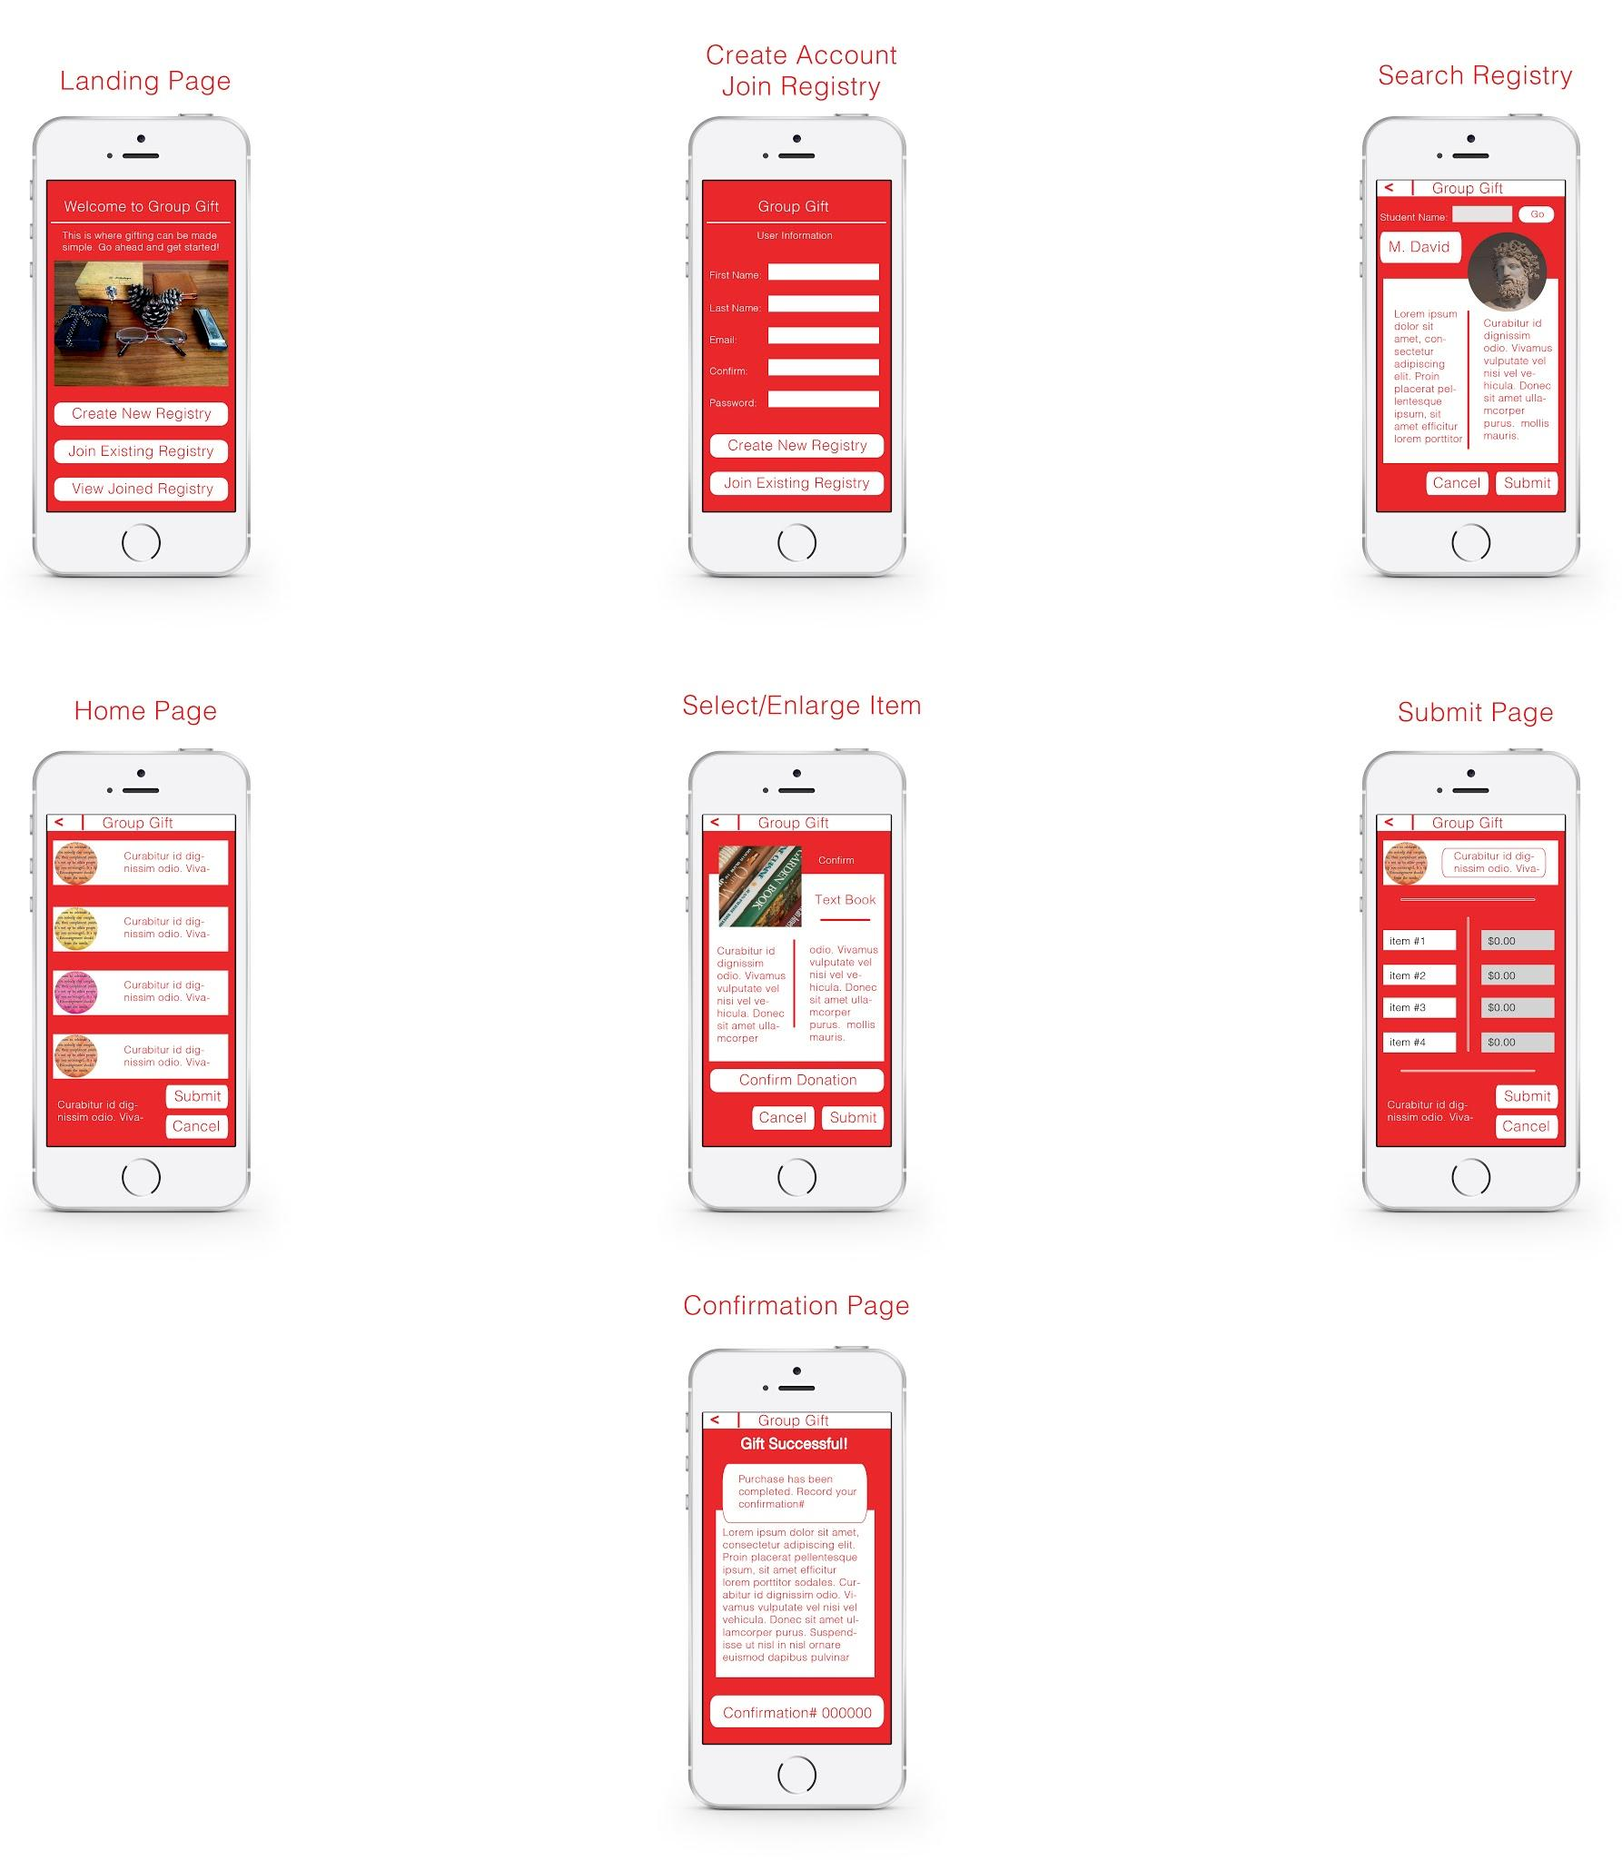
Final Design (Landing Page)
The first page the user will see when the app starts.
The color chosen is red and white. Red with a meaning of urgency.
The carrier settings were removed because of distraction.
Also 2 options are given instead of 3
Here the user is given 2 options:
Create New Registry
Login to Registry

Slide 25
Final Design (Create Account)
The create account page is where you can be a user to receive donations or give donations. Either way the same information is extracted for the donor and recipient.
The page layout is nearly identical the the low fidelity prototype without the carrier settings and the top of the page. So you will be able to create a registry or go back to previous menu.

Slide 26
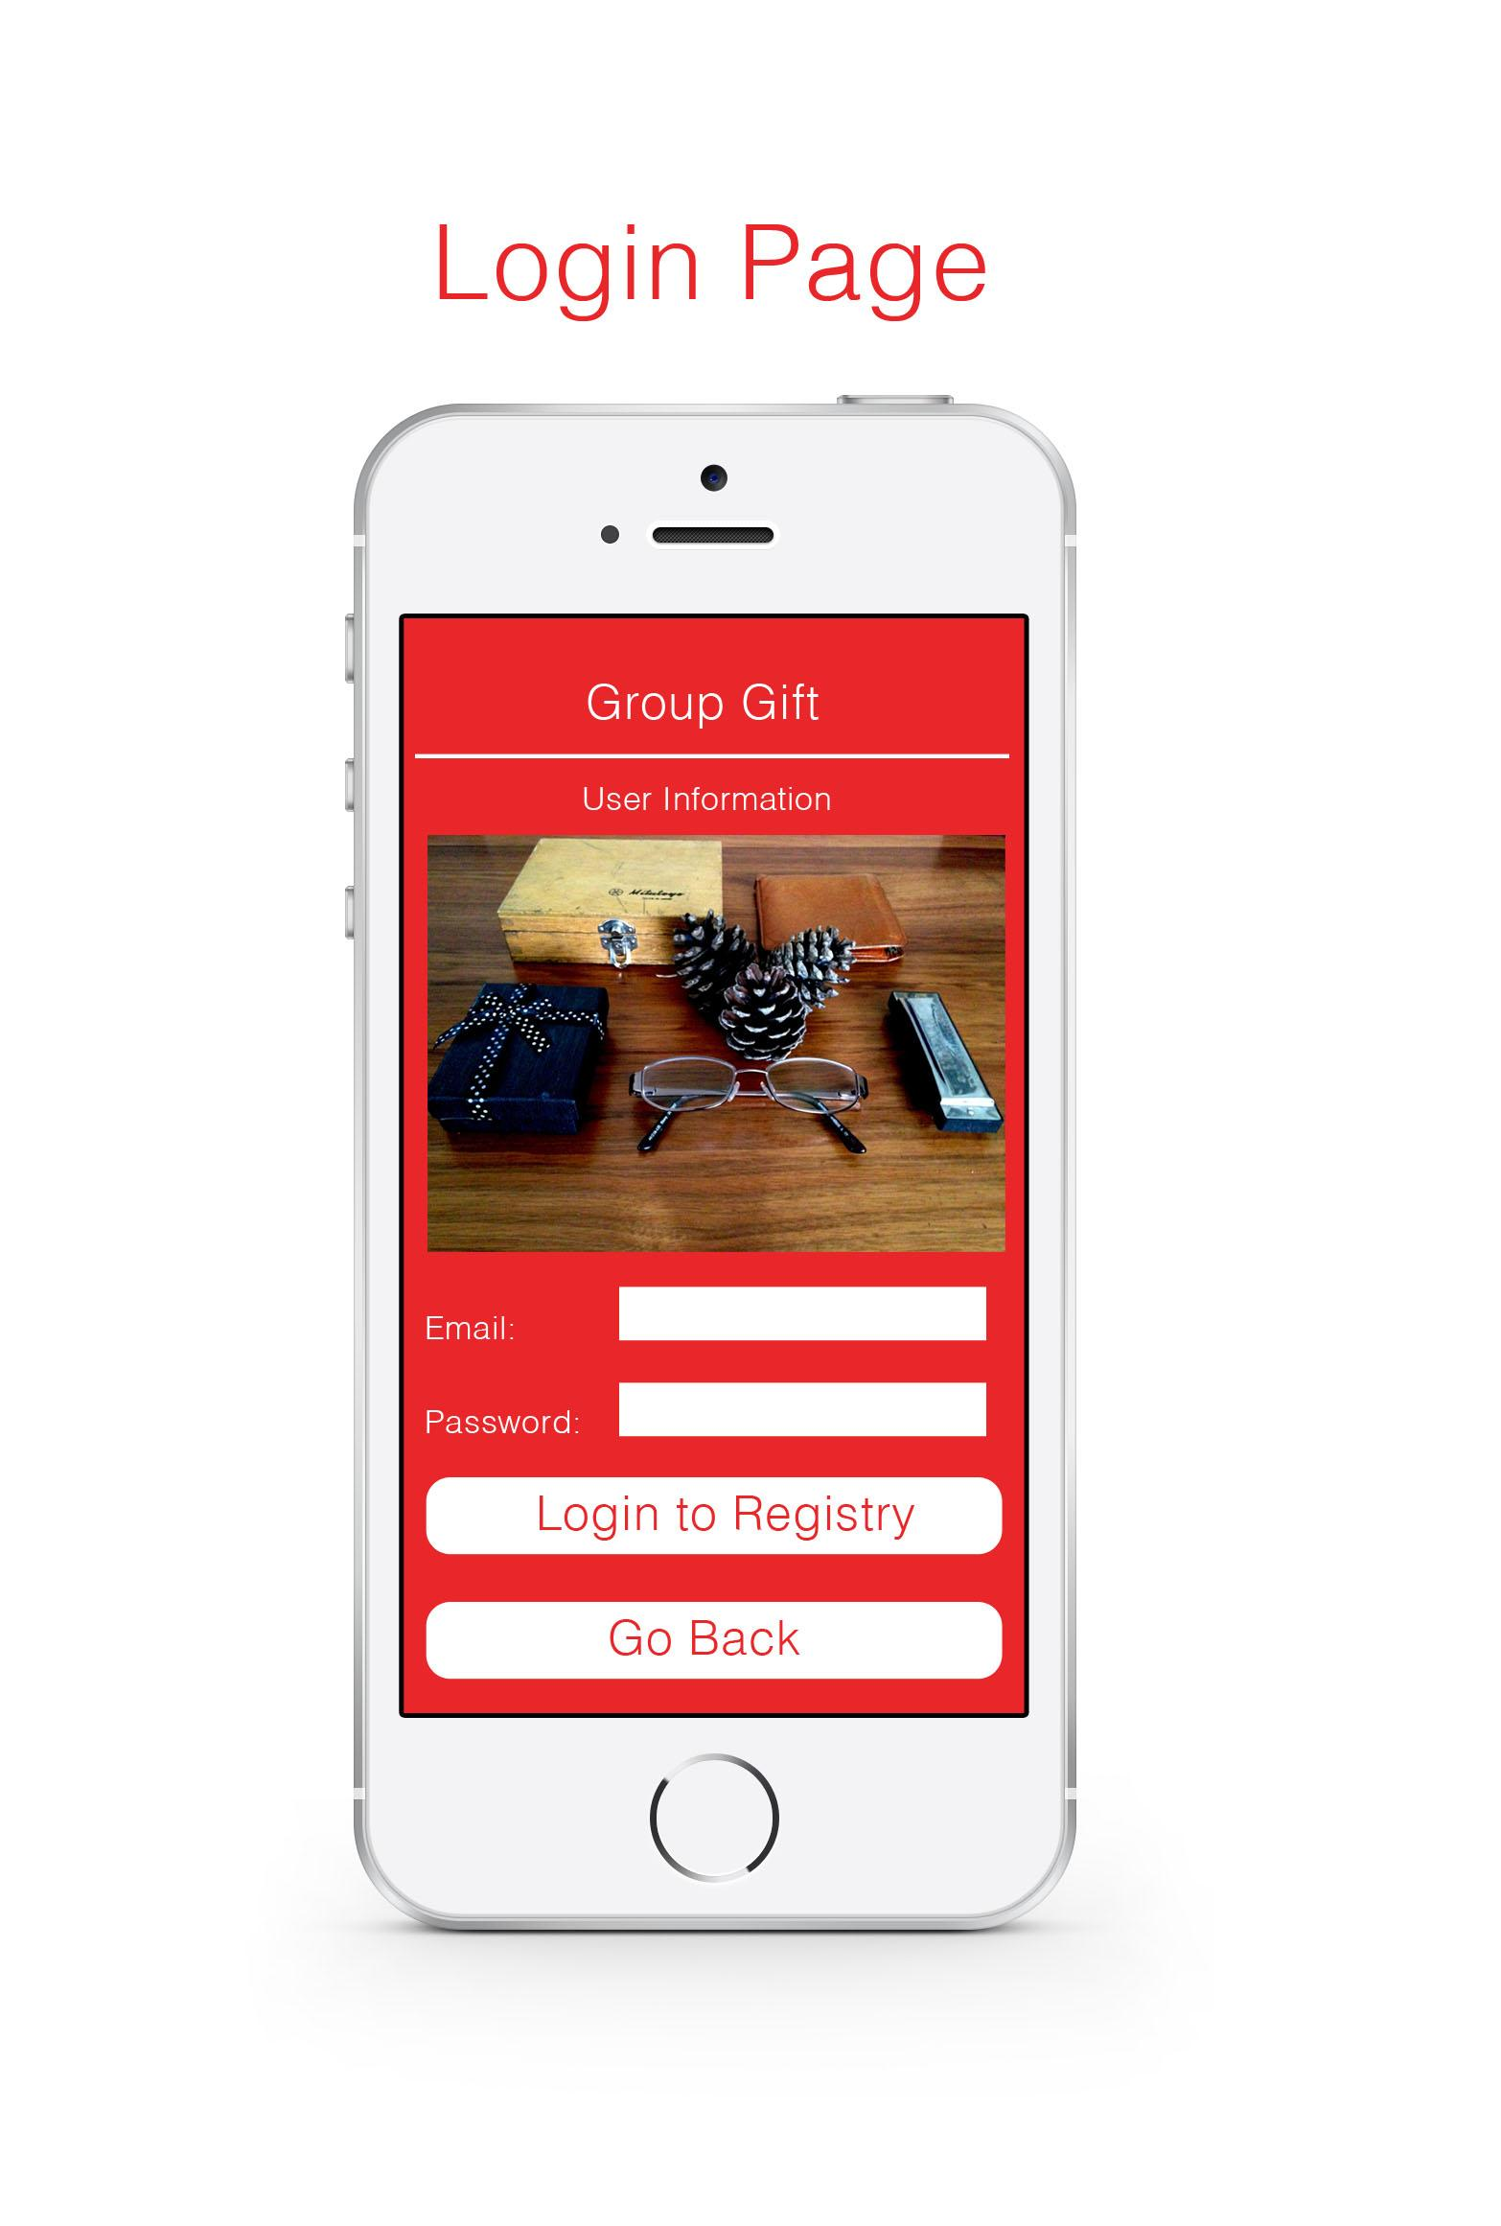
Final Design (Login Page)
The login page is where you can login if you already have an account created.
The validation of this page will also let you know if an account has already been created or not.

Slide 27
Final Design (Search Registry)
This is the page Search registry page.
As stated in the low fidelity prototype as you search the database for users, A different picture of the profile and description will populate the fields.
The word “go” was placed instead or search after typing a name. Then you can submit your selection.

Slide 28
Final Design (Home Page)
The Home Page or the recipient page.
Here you will see an array of items the the recipient desires.
Also from the low fidelity we decided to dispose of the text that would have been under the “Groupgift” header above the array of items.

Slide 29
Final Design (Select Item)
Here is the “Select Item” page.
This page also enlarges the item selected.
We agreed that the layout for this page was pretty good.
After thinking about how the user holds the phone, it was obvious that were on the right path.

Slide 30
Final Design (Submit Page)
The submit page displays the items selected or items placed in a cart.
Here you can submit the items chosen or cancel the transaction.
If you have more that one item you want to purchase, you could scroll the page up and down.
The user will automatically be directed to the bottom of the page.

Slide 31
Final Design Confirmation
This is the “Confirmation” page.
You will receive a small modal window allowing you to know that all is great as well as a short description of disclaimers along with a confirmation number.
When you tap the confirmation number the link will give you the option to email the confirmation number to you.

Slide 32
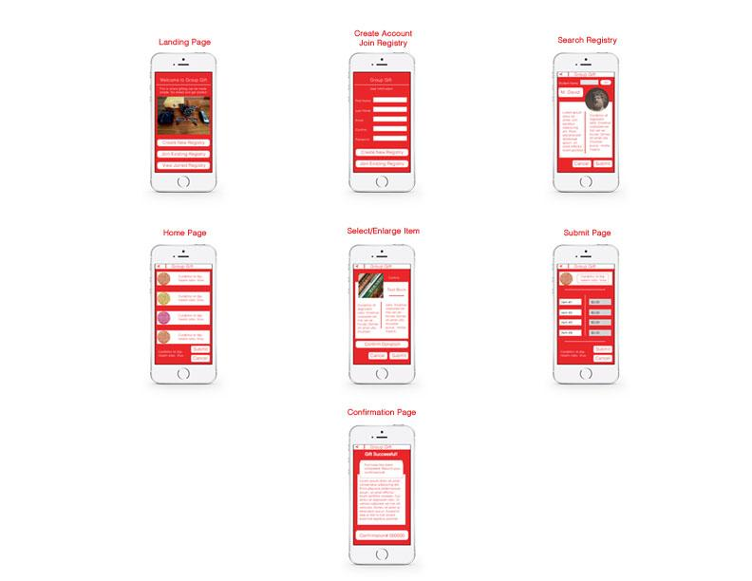
Our Final Design
Here is our final design for the Group Gift app. It shows all of the major pages of this application.

